Slide 1

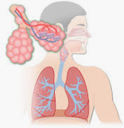
respiratory system
Dr P. Mary Anupama
Assistant Professor
Dept. of Biochemistry
St. Joseph’s college for Women (A)
Visakhapatnam

Slide 2
Contents:
Components of respiratory system
Physiology of respiration
Diffusion of oxygen and CO₂
Transport of oxygen
Role of hemoglobin
Dissociation curve of oxyhemoglobin and its significance
Bohr’s effect; transport of CO₂ and chloride shift; Various buffer system of the blood
Acid-base balance, factors affecting acid-base balance
Acidosis and alkalosis
Role of lung in regulation of acid-base balance.

Slide 3
FUNCTIONS OF RESPIRATORY SYSTEM
- BREATHING or ventilation
- EXTERNAL RESPIRATION, which is the exchange of gases (oxygen and carbon dioxide) between inhaled air and the blood.
- INTERNAL RESPIRATION, which is the exchange of gases between the blood and tissue fluids.
CELLULAR RESPIRATION
In addition to these main processes, the respiratory system serves for:
- REGULATION OF BLOOD ph, which occurs in coordination with the kidneys, and
- as a DEFENSE AGAINST MICROBES
- Control of body temperature due to loss of evaporate during expiration

Slide 4
Components of respiratory system
The organs of the respiratory system make sure that oxygen enters our bodies and carbon dioxide leaves our bodies.
The respiratory tract is the path of air from the nose to the lungs.
It is divided into two sections: Upper Respiratory Tract and the Lower Respiratory Tract.
Upper respiratory tract comprises of Nostrils, Nasal Cavities, Pharynx, Epiglottis and the Larynx.
The lower respiratory tract consists of the Trachea, Bronchi, Bronchioles and the Lungs.
As air moves along the respiratory tract it is warmed, moistened and filtered.

Slide 5
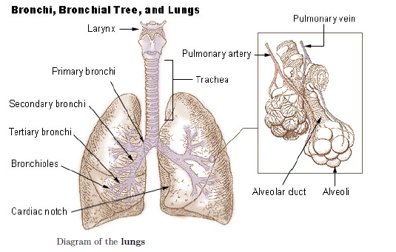

Slide 6
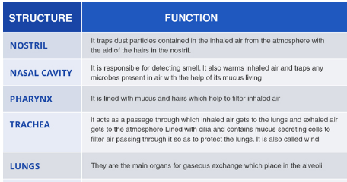

Slide 7
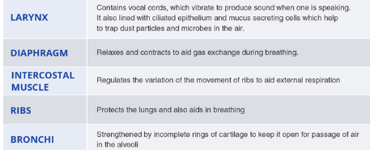

Slide 8
PHYSIOLOGY OF RESPIRATION
• Breathing is the process that moves air in and out of the lungs
• Breathing is inhaling Oxygen (O₂) and exhaling Carbon Dioxide (CO₂)
The main difference between Respiration and Breathing is Energy. Energy is one of the end-products of respiration.
Respiration is a process and also involves mechanisms.
Breathing is also referred to as external respiration or gaseous exchange.

Slide 9
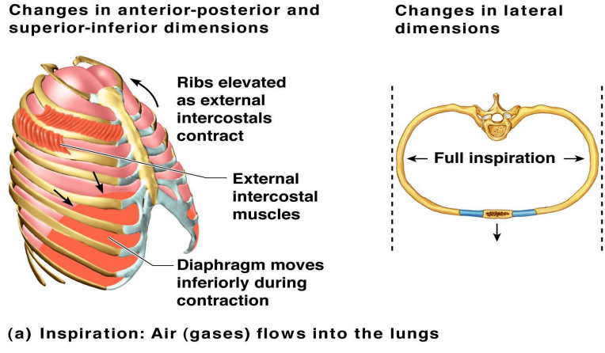
inspiration

Slide 10
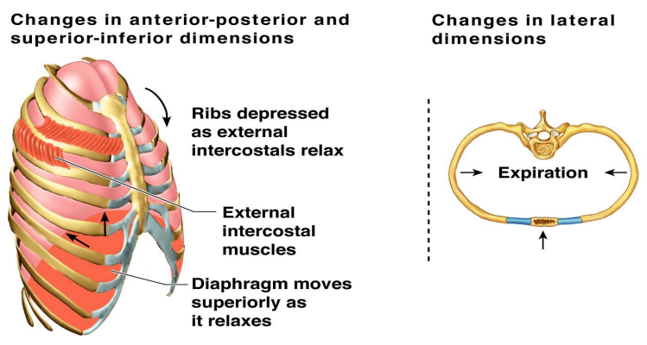
expiration

Slide 11
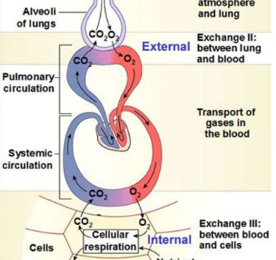
PROCESS OF RESPIRATION

Slide 12
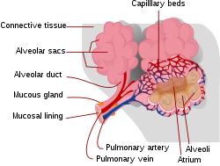
Diffusion of oxygen and CO₂
This process occurs by simple diffusion, across a very thin membrane (known as the blood–air barrier), which forms the walls of the pulmonary alveoli.
It consisting of the alveolar epithelial cells, their basement membranes and the endothelial cells of the alveolar capillaries
This blood gas barrier is extremely thin (in humans, on average, 2.2 μm thick). It is folded into about 300 million small air sacs called alveoli.

Slide 13
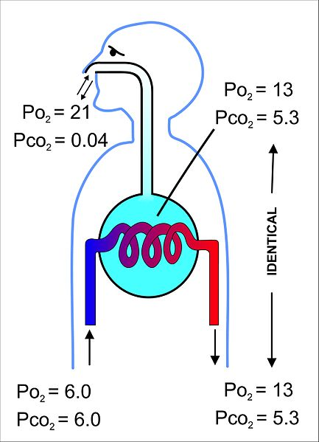
Partial pressure of oxygen in lungs is 13-14 kPa (100 mmHg), and a partial pressure of carbon dioxide of 5.3 kPa (40 mmHg) (i.e. the same as the oxygen and carbon dioxide gas tensions as in the alveoli). This difference in partial pressure is responsible for exchange of gases.
Similarly, since the blood arriving in the alveolar capillaries has a partial pressure of CO₂ of also about 6 kPa (45 mmHg), whereas that of the alveolar air is 5.3 kPa (40 mmHg), there is a net movement of carbon dioxide out of the capillaries into the alveoli.

Slide 14
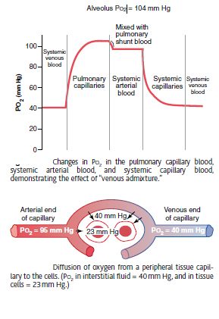

Slide 15
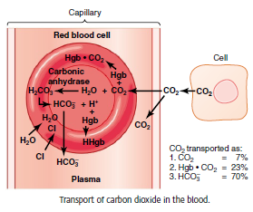

Slide 16
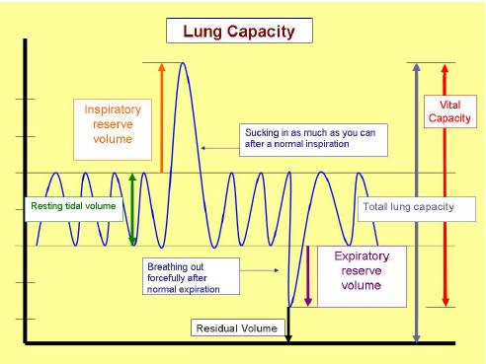

Slide 17
Respiratory Volumes and Capacities • Tidal Volume (TV) =Normal breathing moves about 500 mL of air with each breath • Inspiratory reserve volume (IRV) – Amount of air that can be taken in forcibly over the tidal volume – Usually between 2100 and 3200 mL • Expiratory reserve volume (ERV) – Amount of air that can be forcibly exhaled – Approximately 1200 mL

Slide 18
Residual volume (RV) – Air remaining in lung after expiration – About 1200 ml • Vital capacity – The total amount of exchangeable air – Vital capacity = TV + IRV + ERV • Functional volume – Air that actually reaches the respiratory zone – Usually about 350 mL

Slide 19
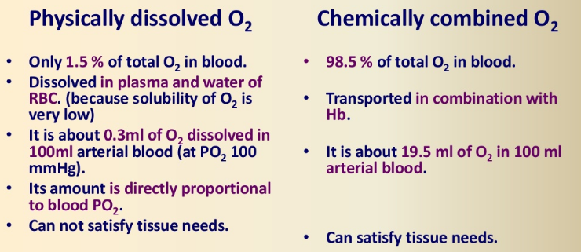

Slide 20
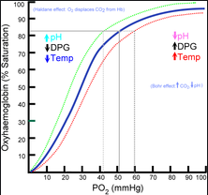
The oxygen–haemoglobin dissociation curve
oxyhemoglobin dissociation curve relates oxygen saturation (SO₂) and partial pressure of oxygen in the blood (PO₂), and is determined by what is called "hemoglobin affinity for oxygen"
Oxyhemoglobin dissociation curve relates oxygen saturation (SO₂) and partial pressure of oxygen in the blood (PO₂), and is determined by "hemoglobin affinity for oxygen"

Slide 21
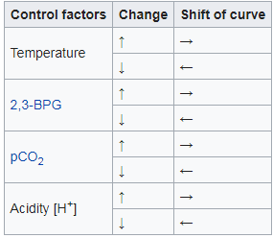
Factors that affect standard dissociation curve

Slide 22
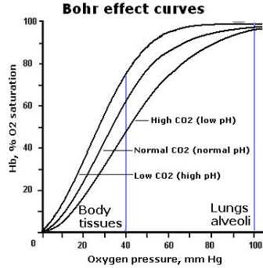
Bohr’s effect
Bohr effect refers to the shift in the oxygen dissociation curve caused by changes in the concentration of carbon dioxide or the pH of the environment.
Since carbon dioxide reacts with water to form carbonic acid, an increase in CO₂ results in a decrease in blood pH, resulting in hemoglobin proteins releasing their load of oxygen. Conversely, a decrease in carbon dioxide provokes an increase in pH, which results in hemoglobin picking up more oxygen.

Slide 23

When a tissue's metabolic rate increases, so does its carbon dioxide waste production. When released into the bloodstream, carbon dioxide forms bicarbonate and protons
This causes the pH of the blood to decrease, which promotes the dissociation of oxygen from haemoglobin, and allows the surrounding tissues to obtain enough oxygen to meet their demands.
In areas where oxygen concentration is high, such as the lungs, binding of oxygen causes haemoglobin to release protons, which recombine with bicarbonate to eliminate carbon dioxide during exhalation.
These opposing protonation and deprotonation reactions occur in equilibrium resulting in little overall change in blood pH

Slide 24
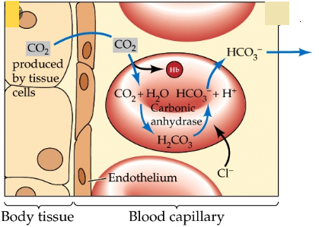
Chloride shift
It refers to the exchange of bicarbonate (HCO₃⁻) and chloride (Cl⁻) across the membrane of red blood cells (RBC)
Cell membranes are generally impermeable to charged ions (i.e. H⁺, HCO₃⁻ ) but RBCs are able to exchange bicarbonate for chloride using the anion exchanger proteins.
This rise in intracellular bicarbonate leads to bicarbonate export and chloride intake is referred to as "chloride shift”.

Slide 25
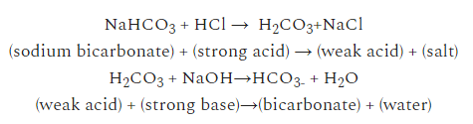
Various buffer system of the blood
BICARBONATE-CARBONIC ACID BUFFER: The bicarbonate is regulated in the blood by sodium, as are the phosphate ions.
When sodium bicarbonate (NaHCO₃), comes into contact with a strong acid, such as HCl, carbonic acid (H₂CO₃), which is a weak acid, and NaCl are formed.
When carbonic acid comes into contact with a strong base, such as NaOH, bicarbonate and water are formed.
Bicarbonate ions and carbonic acid are present in the blood in a 20:1 ratio if the blood pH is within the normal range.
With 20 times more bicarbonate than carbonic acid, this capture system is most efficient at buffering changes that would make the blood more acidic.

Slide 26
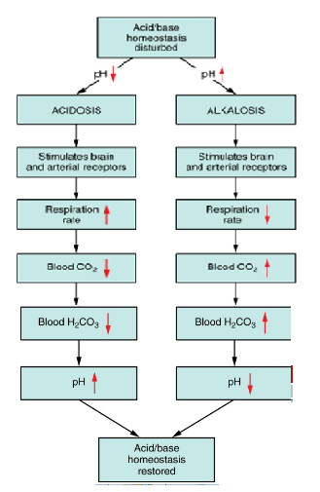
Respiratory Regulation of Blood pH. The respiratory system can reduce blood pH by removing CO2 from the blood.

Slide 27
ACID – BASE IMBALANCE
Most acid-base disturbances result from
disease or damage to organs (kidney, lungs, brain) whose normal function is necessary for acid-base homeostasis,
disease which causes abnormally increased production of metabolic acids such that homeostatic mechanisms are overwhelmed medical intervention (e.g. mechanical ventilation, some drugs)

Slide 28
Respiratory acidosis – (raised pCO₂(a), reduced pH)
It is characterized by increased pCO₂(a) due to inadequate alveolar ventilation (hypoventilation) and consequent reduced elimination of CO₂ from the blood. Respiratory disease, such as bronchopneumonia, emphysema, asthma and chronic obstructive airways disease, may all be associated with hypoventilation sufficient to cause respiratory acidosis.
Some drugs (e.g. morphine and barbiturates) can cause respiratory acidosis by depressing the respiratory center in the brain. Damage or trauma to the chest wall and the musculature involved in the mechanics of respiration may reduce ventilation rate. This explains the respiratory acidosis that can complicate the course of diseases such as poliomyelitis, Guillain-Barre syndrome and recovery from severe chest trauma.

Slide 29
Respiratory alkalosis – (reduced pCO₂(a), increased pH)
By contrast, respiratory alkalosis is characterized by decreased pCO₂(a) due to excessive alveolar ventilation and resulting excessive elimination of CO₂ from blood. Disease in which, due to reduced oxygen in blood (hypoxemia), the respiratory center is stimulated can result in respiratory alkalosis.
Examples here include severe anemia, pulmonary embolism and adult respiratory syndrome. Hyperventilation sufficient to cause respiratory alkalosis can be a feature of anxiety attacks and response to severe pain. One of the less welcome properties of salicylate (aspirin) is its stimulatory effect on the respiratory center. This effect accounts for the respiratory alkalosis that occurs following salicylate overdose. Finally, overenthusiastic mechanical ventilation can cause respiratory alkalosis.

Slide 30
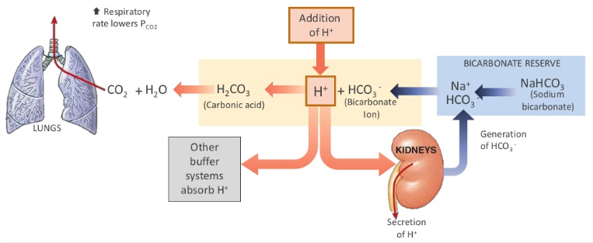

Slide 31
Thank you

